Slide 1

Connected Cars
Mosaab Muhammed
Al-Azhar University

Slide 2
Class Diagram

Slide 3
The Big Picture:
In this project, data from a moving vehicle using ODB II dongle is streamed real time to a server running Spring XD. Spring XD ingests the data and makes predictions about where the vehicle is going and how far it can go. An HTML/AngularJS based dashboard provides real time analytics illustrating the current position of the car, some of the basic telemetry available from the car as well as the predictions.

Slide 4
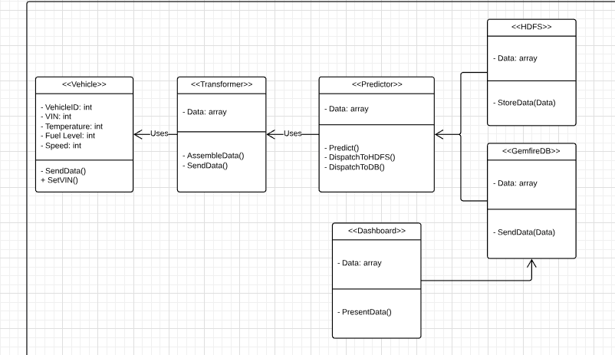

Slide 5

Second Diagram
Use Case Diagram

Slide 6
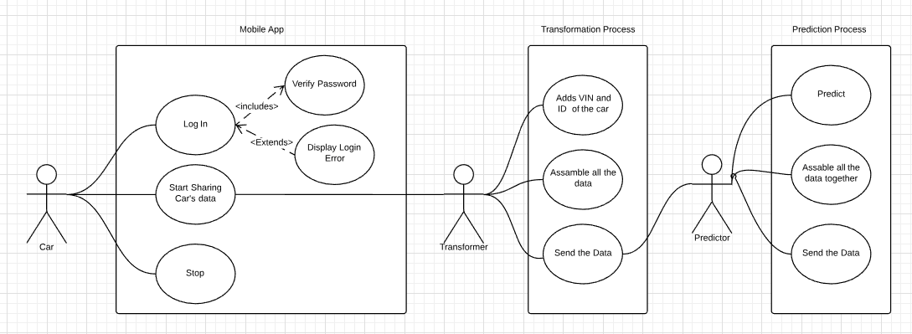

Slide 7
THANK YOU!

